Slide 1
Genesee-Livingston-Orleans-Wyoming Local Workforce Development Area
SUMMER YOUTH EMPLOYMENT PROGRAM
189 YOUTH SERVED

Slide 2
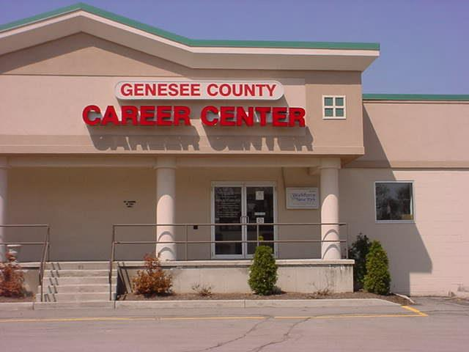
Genesee County Job Development Bureau

Slide 3
Genesee County Summer Youth Employment Program
2020
Worksites

Slide 4
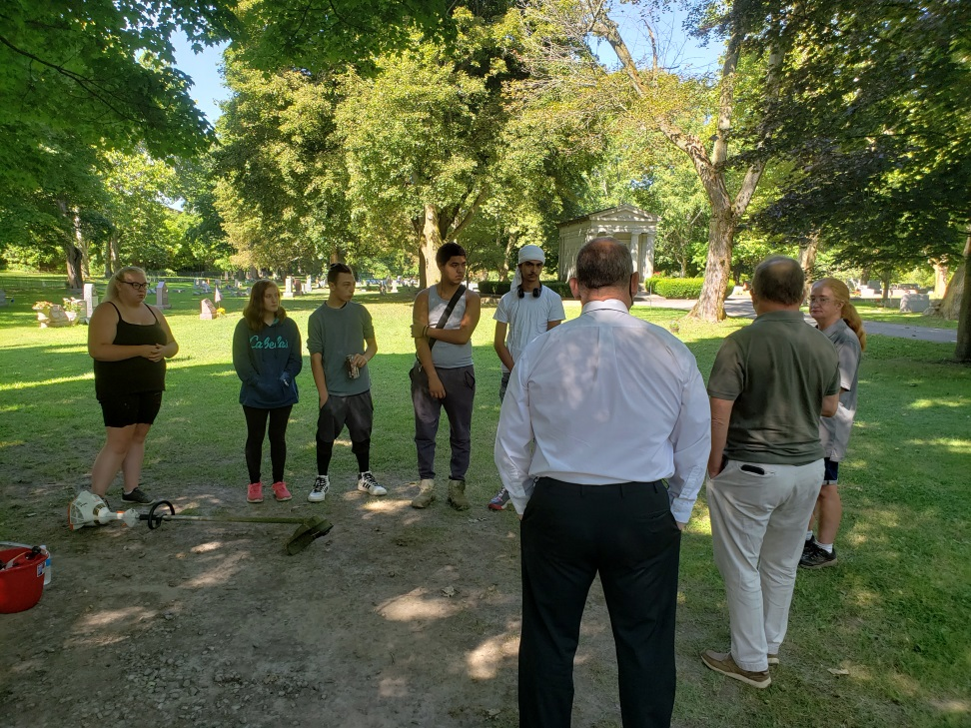
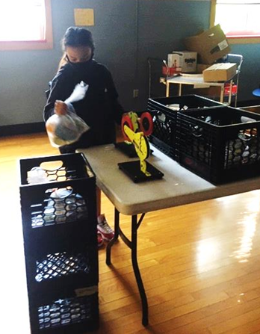
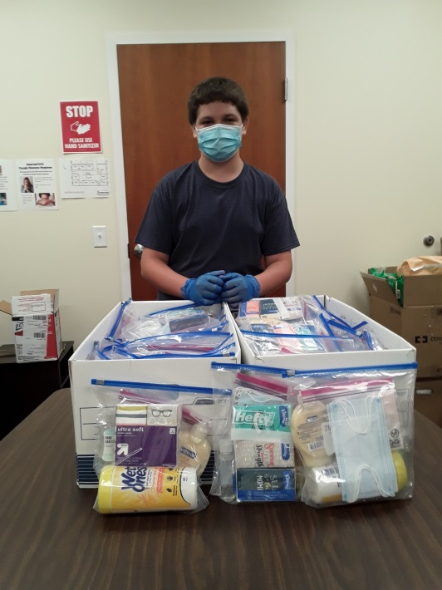
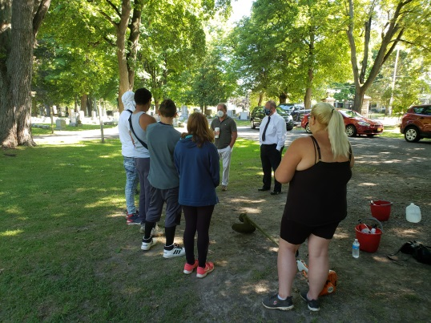
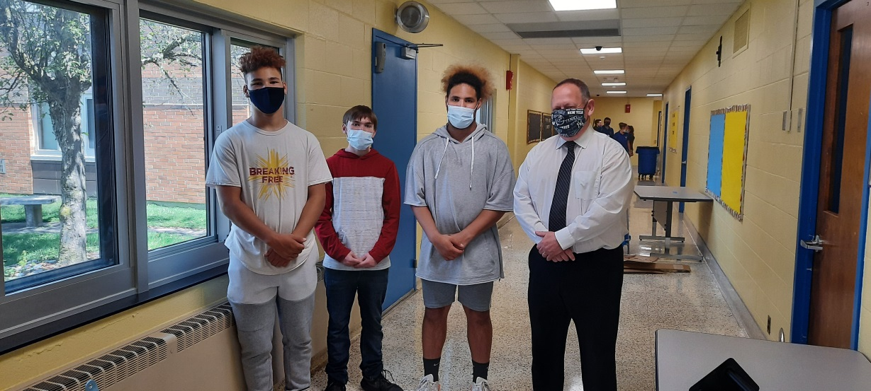
Hard at WOrk

Slide 5
Success Stories
Nicholas has assisted with cleaning, sanitizing, and organizing our loan closet. He created PPE kits to go out to individuals experiencing homelessness in our community. Nicholas states that he enjoys the opportunity to work in a place that serves the community.
Mekhi has been hired on by his summer worksite. He is saving to buy a house!
Many doubted TaCarie but he used that as motivation. He did great and assisted his peers to do great as well.
Brilyn was super in all areas but I loved her great, can-do attitude!
Ashanti is now working toward getting her
High School Equivalency
Lucie is a real Gem!
Hard to believe she is only 14, mature beyond her years and very intelligent!! Great choice for our office!
Dan arrives to work every day with a positive attitude. He works in an efficient manner and produces quality work. He was a huge asset to our team and I wish to have him back next year.
Anthony
was close to being let go from his site; he turned it around – doing less talking and more working! Most Improved
Johnnie has done a great job, takes initiative, and is a valuable asset.
He has been HIRED!

Slide 6
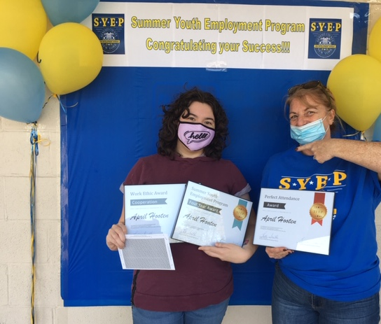
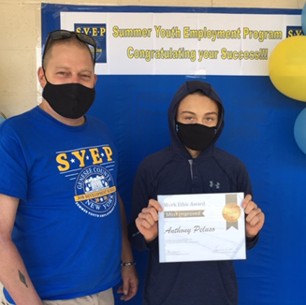
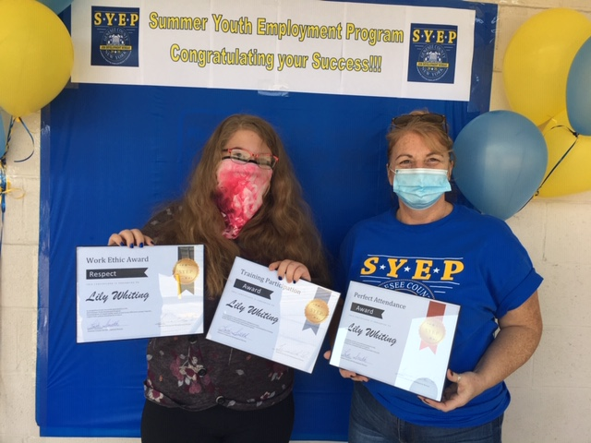
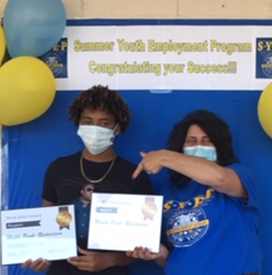
Work Ethic - Cooperation
Most Improved
Perfect Attendance,
Work Ethic – Respect,
Training Participation
Perfect Attendance,
Work Ethic – Cooperation,
4 years in program
AWARDS
Great
Attitude
Perfect Attendance
Work
Ethic
Respect
4 years in program
Perfect Attendance & Work Ethic- Great Attitude
Perfect Attendance &
Work Ethic - Respect
Training Participation

Slide 7
Livingston County Office of Workforce Development

Slide 8
Livingston Summer of ZOOM
On-line Interviews
3 day Orientation
43 TANF Hired
1 WIOA Hired
5 Recruited for Year Round Young Adult Program

Slide 9
Livingston Summer of Crews
3 Crews Served 15 business locations
3 College age adults hired to supervise youth and coordinate projects
No worksite contract required when supervised by county employees

Slide 10
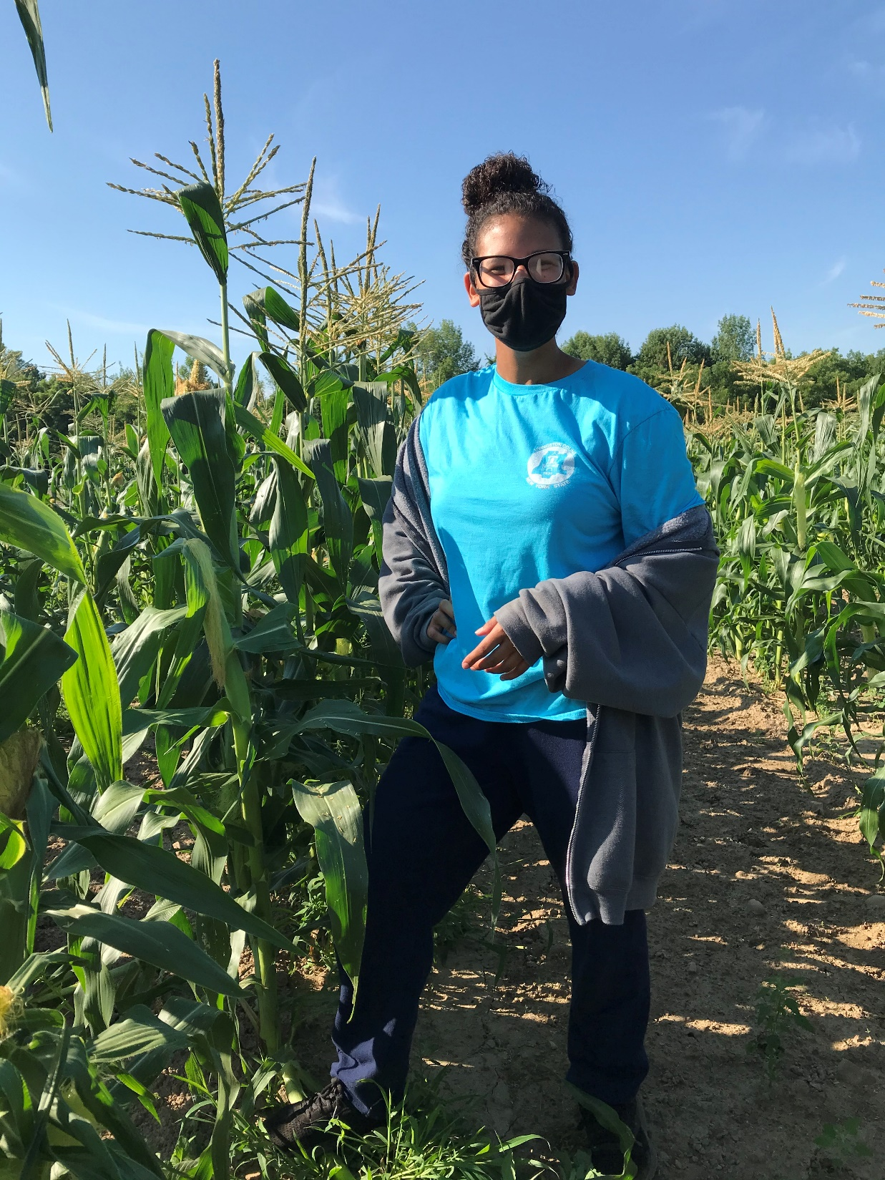
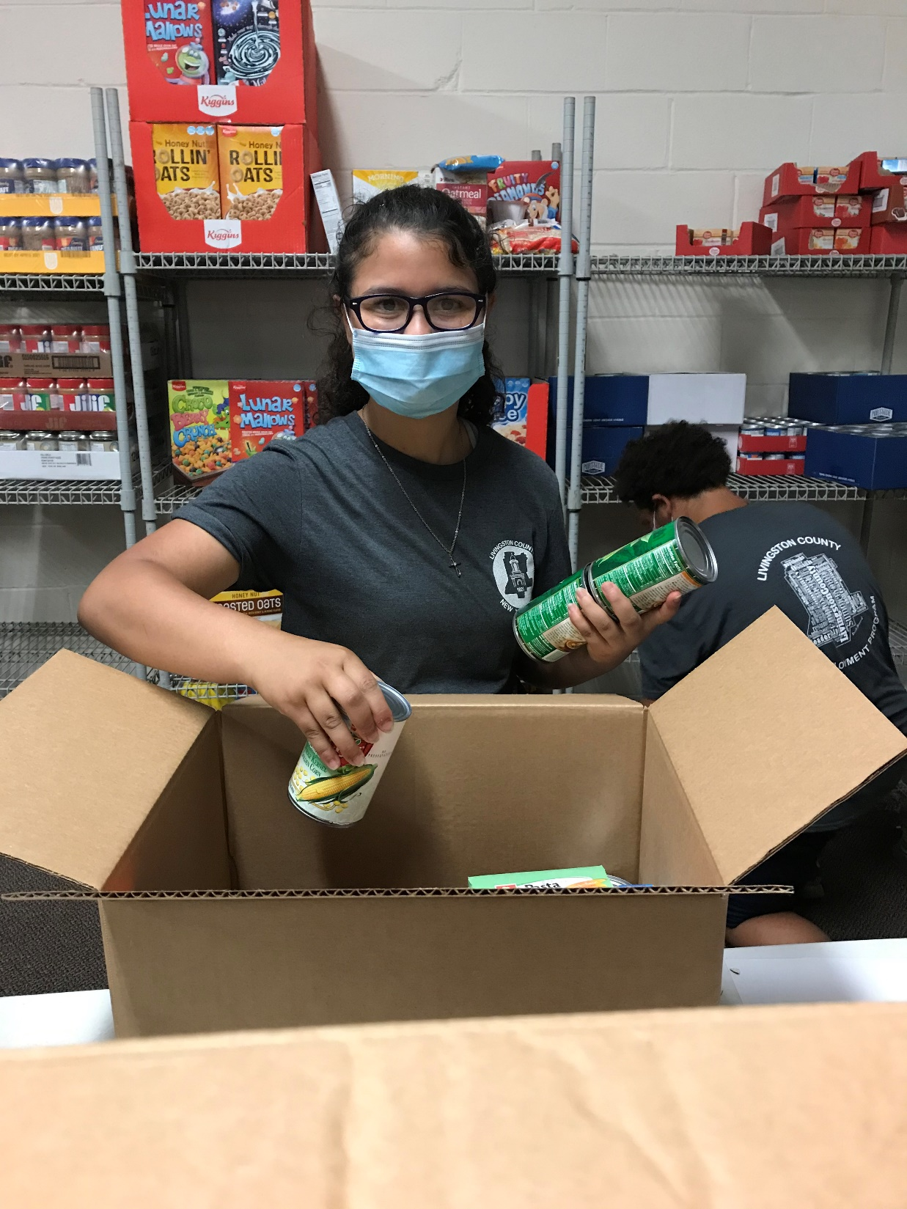
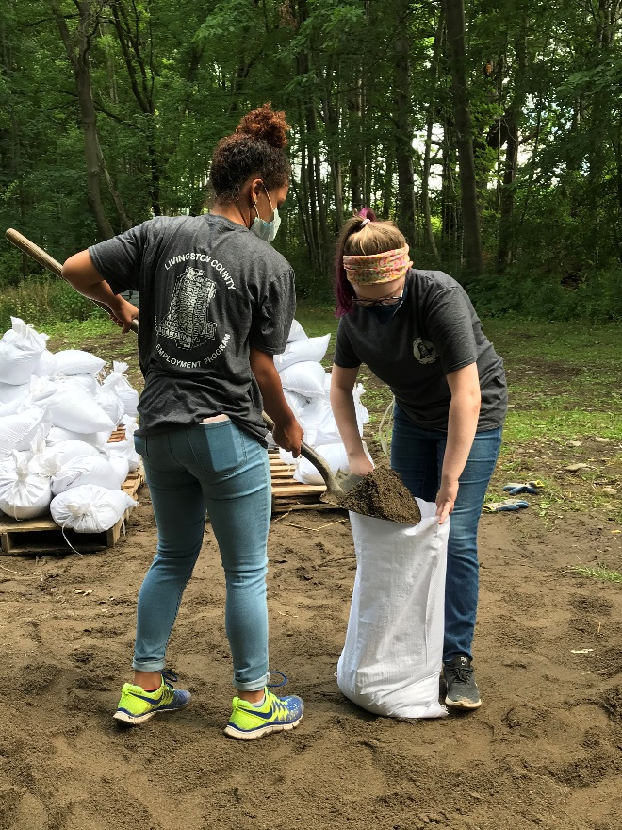
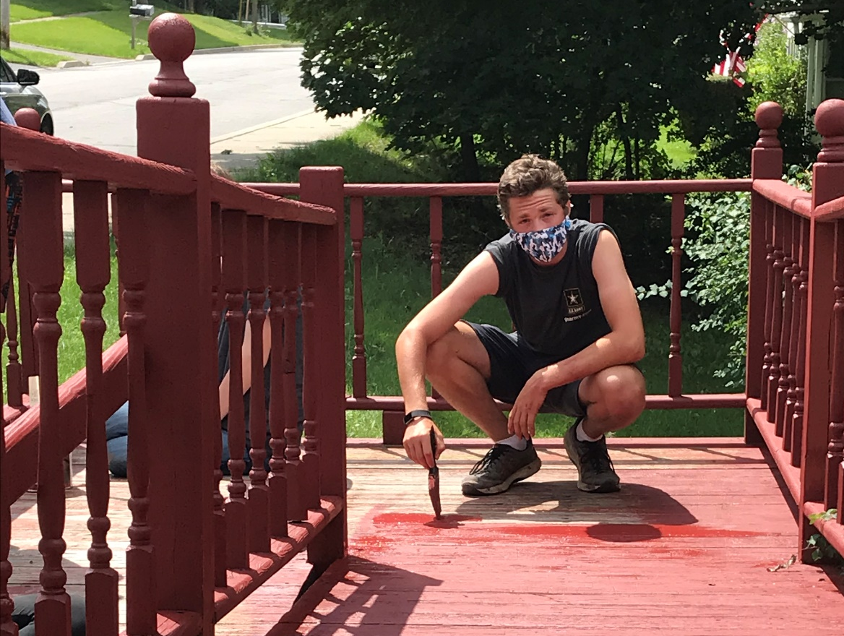
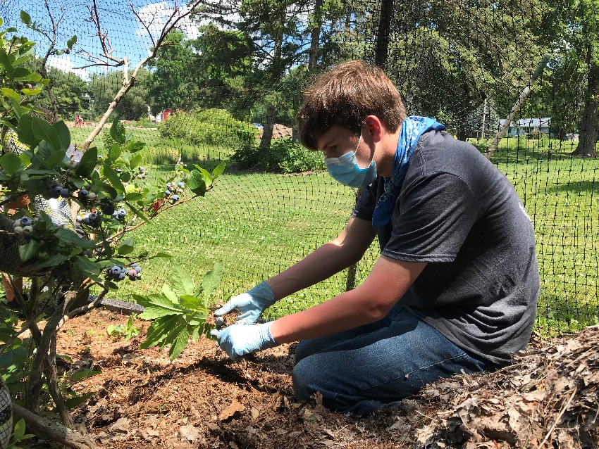
Livingston Summer of COVID
Policy required daily temperature check for crews and symptoms required doctors note
9 Weeks employed with zero diagnosis
Provided hand sanitizer and masks

Slide 11
Orleans County Job Development Agency

Slide 12
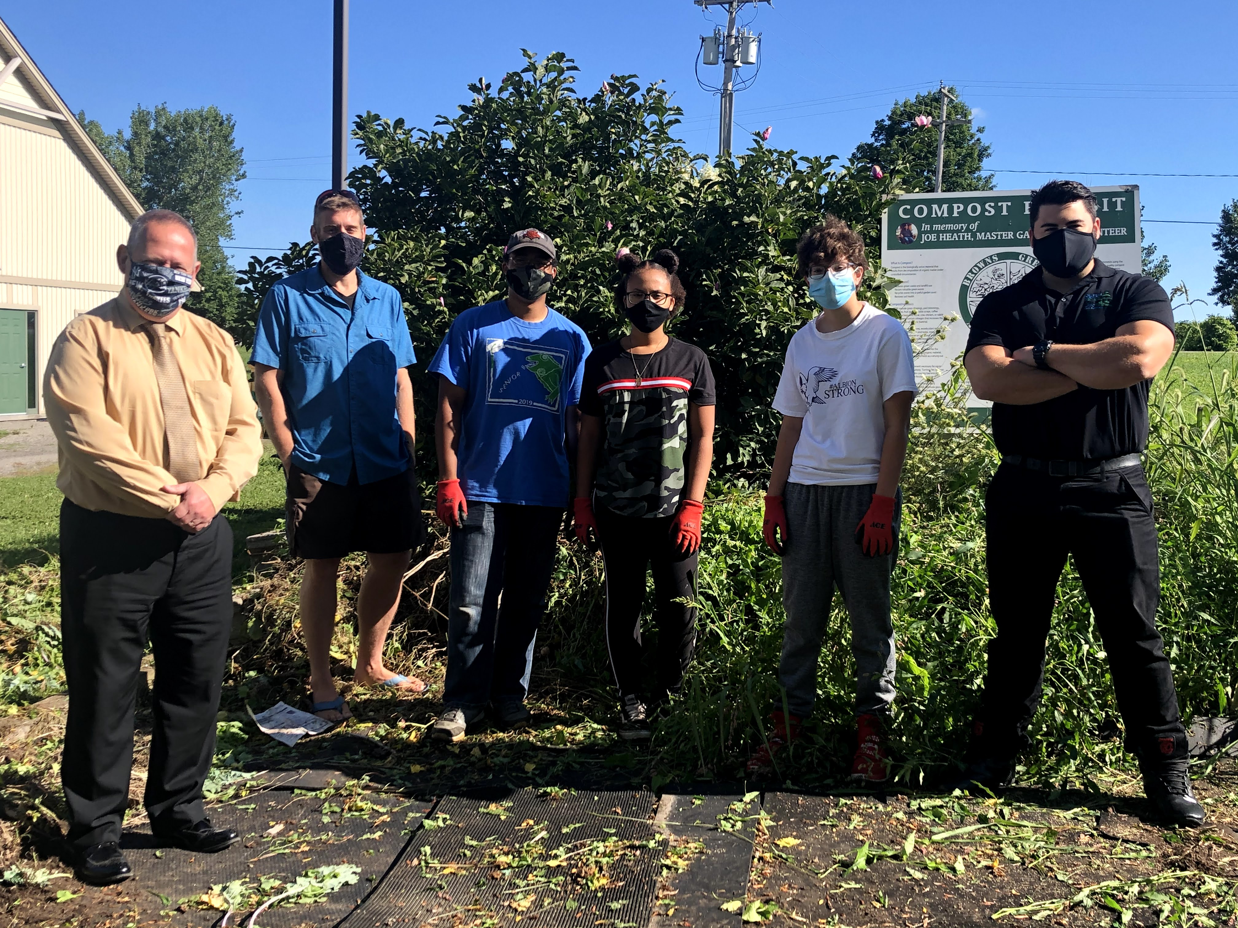
Orleans County Summer Youth Employment Program 2020
Orleans County Cornell Cooperative Extension (from left to right): Jay Lazarony – GLOW WDB, Robert Batt – OCCCE, Detonse Burroughs, Tyana Burroughs, Kayli Miller, & Peter Anderson - OCJDA
21 Youth Participants
16 Work Sites
10 weeks (July-September)

Slide 13
Job Skills Learned by 2020 Summer Youth Participants
Included, for example:
Maintaining Grounds
Rebuilding & Resurfacing Picnic Tables
Restoring Exhibits
Basic Construction Skills
Customer Service
Childcare
Retail
Orleans County DPW (from left to right):
John Papponetti – Orleans County DPW, Adam Kremblas, Cole Seefeldt, Peter Anderson – OCJDA, & Jay Lazarony – GLOW WDB

Slide 14
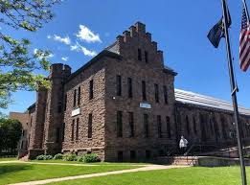
We were very proud of each and every one of our youth participants for their diligence in staying safe and healthy during this challenging time period. The location supervisors reported that the youth were hard workers, showed up on time, gave 100% effort and got along well with the permanent staff.

Slide 15
Wyoming County Community Action

Slide 16
Wyoming County 2020 SYEP Statistics
Total Youth Served - 27
Age 14 - 3
Age 15 - 1
Age 16 - 4
Age 17 - 4
Age 18 - 6
Age 19 - 6
Age 20 - 3
Youth Served by Zip Code
Arcade - 2
Bliss - 1
Castile - 6
Gainesville - 2
Pavilion - 1
Perry - 5
Pike - 4
Warsaw - 5
Wyoming - 1
Participant
Characteristics
Female - 12
Male - 15
Ethnicity
White - 26
Pacific Islander - 1
All 27 youth successfully participated and completed their 125-200 hour paid work experiences at various worksites throughout the County.
School Status
In School Youth - 15
Out of School Youth - 12
2020 Summer Youth Employment Program

Slide 17
Nonprofit
Wyoming County Chamber of Commerce – 1 placement
Community Action for Wyoming County – 3 placements
Wyoming County Fair Association – 2 placements
Warsaw Historical Society – 2 placements
Angel Action – 1 placement
Wyoming County 2020 SYEP Worksites
Public
Wyoming County Community Health Systems – 1 placement
Wyoming County Animal Control – 2 placements
Perry Central School – 3 placements
Letchworth Central School – 2 placements
Warsaw Central School – 1 placement
Village of Arcade – 2 placements
Village of Wyoming – 1 placement
Private
The Little Red Caboose – 1 placement
Hilltop Gardens and More – 1 placements
Fairview Paper Box Corporation – 1 placements
Tackbary Trophies – 1 placement
Marquart Farms – 1 placement
Domes Tree Farm – 1 placement
2 participants secured employment after completing their Summer work experiences.
2020 Summer Youth Employment Program

Slide 18
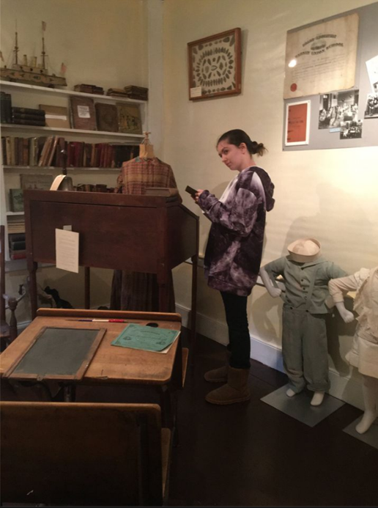
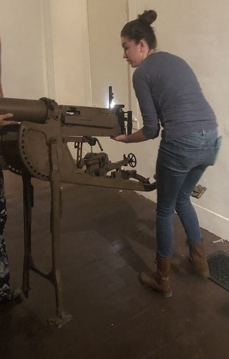
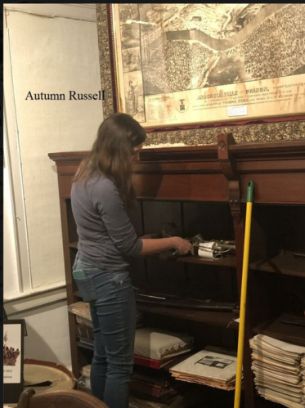
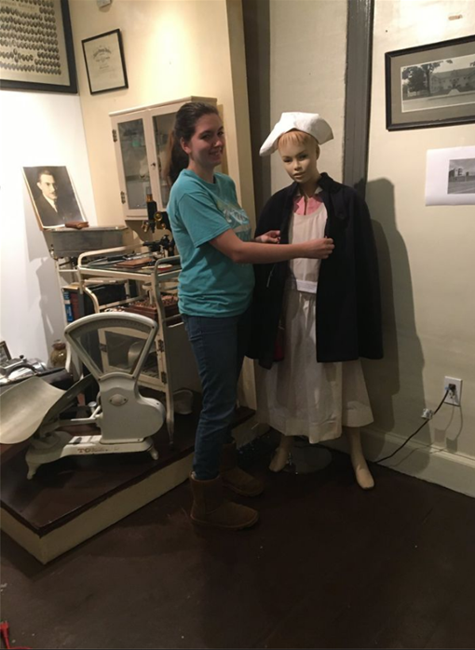
Summer participant Autumn paired her interest in History and Interior Design with a work placement at Warsaw Historical Society where she helped to revamp the Gates House Museum during her time in the program.
2020 Summer Youth Employment Program

Slide 19
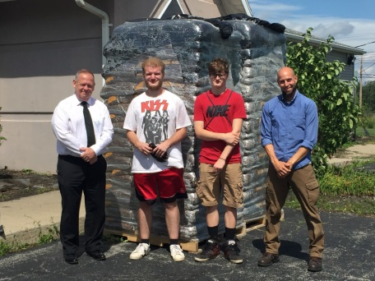
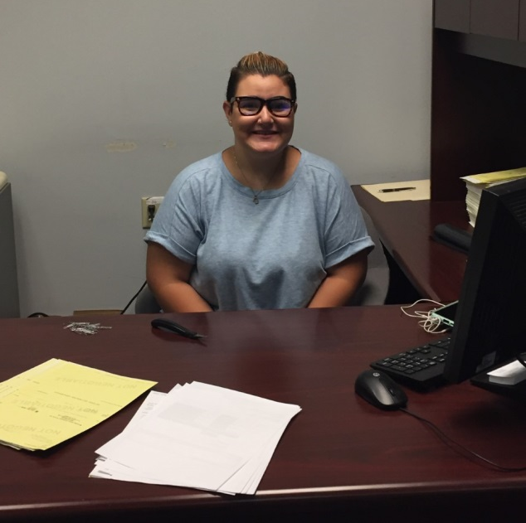
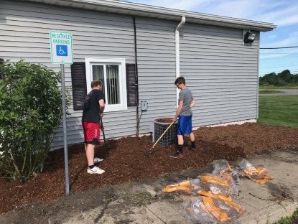
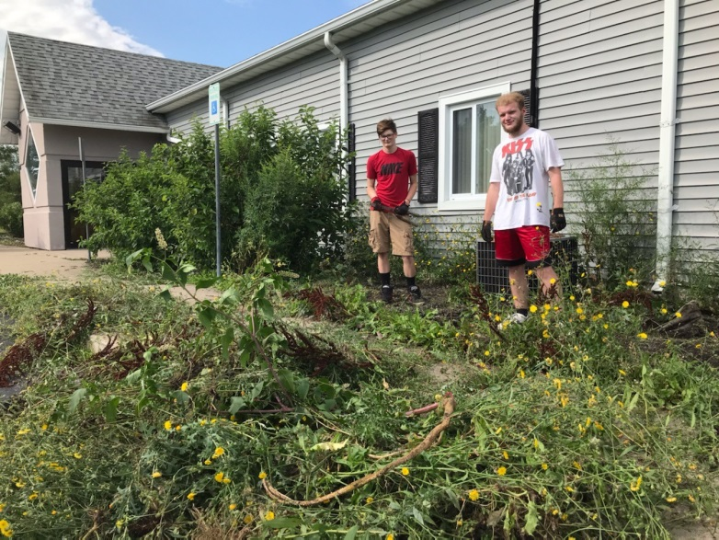
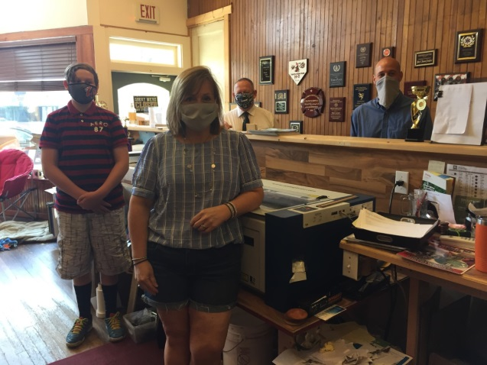
Summer Youth In Action
Madison
Community Action for Wyoming County
- Office Assistant (Finance Department)
Thomas and Bryce
Community Action for Wyoming County
- Mobile Work Crew
Jacob
Tackbary Trophies
- Laser Engraver
2020 Summer Youth Employment Program

Slide 20
Final Thought
Although the 2020 Summer Youth Employment Program came with many new challenges this year compared to those in the past, it did not stifle the youth participants drive to successfully complete the program and adapt to any situations they were face with.
Community Action is thankful to all the County employers that participated this summer who also customized their worksite involvement during the program to allow for this opportunity to take place, even in the face of daily uncertainty.
2020 Summer Youth Employment Program

